Slide 1
What is Unit Test?

Slide 2
What will you learn?
What a unit test is
The differences between shared, private, and volatile dependencies
The two schools of unit testing: classical and London
The differences between unit, integration, and end-to-end tests

Slide 3








The definition of “unit test”
Verifies a small piece of code (known as a unit)
Does it quickly
Does it in an isolated manner

Slide 4

Classical and London school of unit testing
Classical
London Style
Detroit or classicist approach
Test-Driven Development
Kent Beck
mockist
Growing Object-Oriented, Guided by Tests
Steve Neeman and Nat Pryce

Slide 5
Isolation: London take
Isolating the system under test from its collaborators
Replace all dependencies with test double.
Separating the class behavior from external influence

Slide 6
Test double
Object that looks and behaves like its release-intended counterpart
Simplified version
Reduces the complexity and facilitates testing
xUnit Test Patterns: Refactoring Test Code(2007)
Analogy: stunt double in movies

Slide 7
London take
Dependency 1
Test Double
System under test
System under test
Dependency 2
Test Double

Slide 8
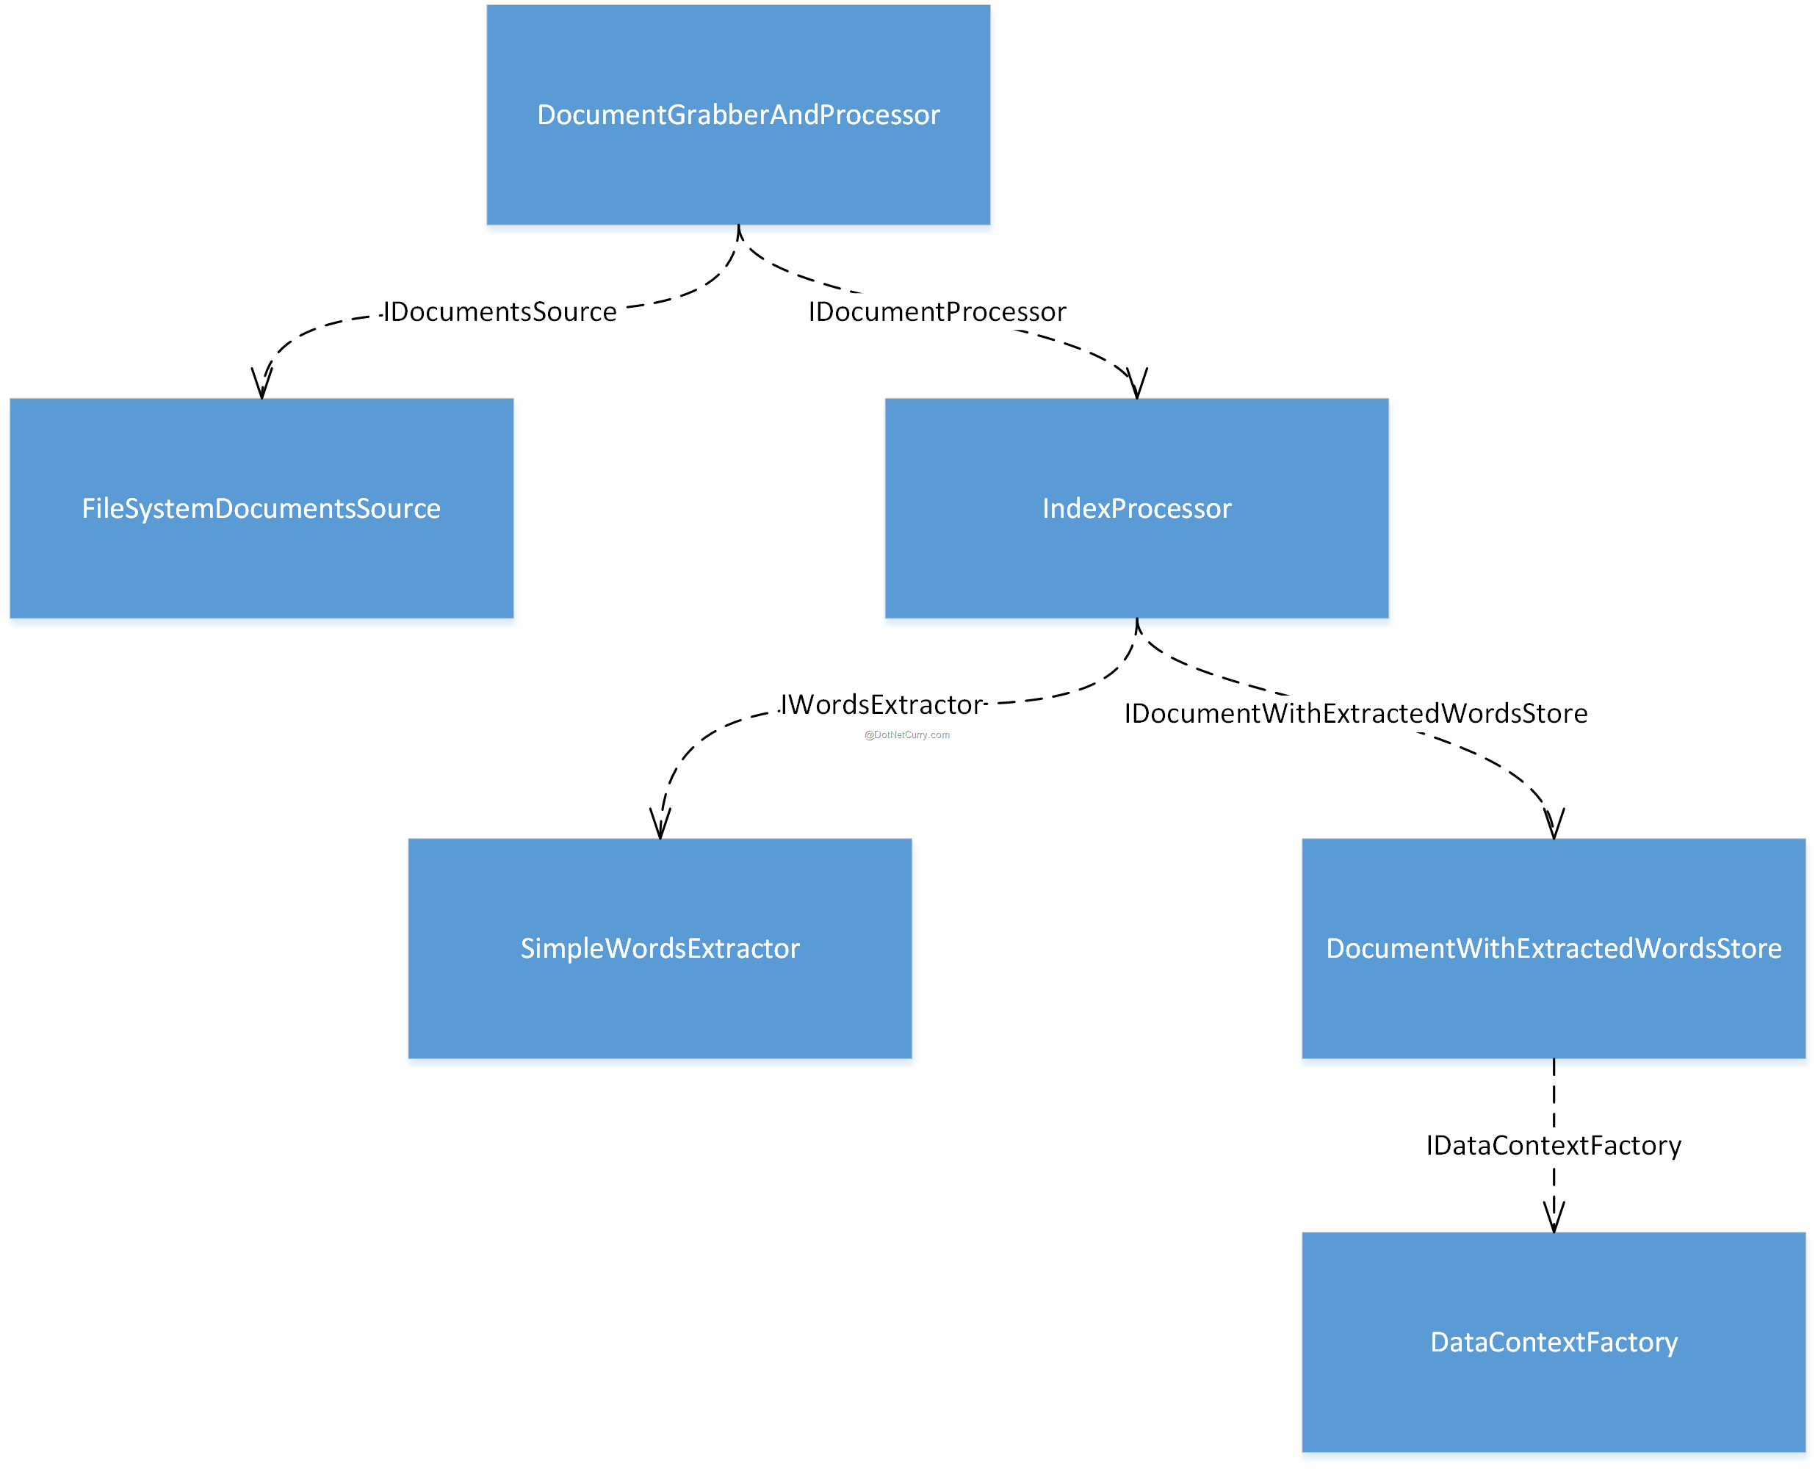
Object graph
Web of communicating classes solving the same problem

Slide 9
Simple test suite structure
One class with tests for each class in the production code
Class 1 Tests
Class 1
Class 2 Tests
Class 2
Class 3 Tests
Class 3

Slide 10
Tests written using the classical style of unit testing
One class with tests for each class in the production code
Reduces the product amount in
the store by five

Slide 11
Tests written using the classical style of unit testing
The product amount in the
store remains unchanged.

Slide 12
Method under test (MUT)
Method in the SUT called by the test
MUT refers to the method and SUT refers to the whole class

Slide 13
Mock
Special kind of test double
Allows you to examine interactions between the SUT and its collaborators

Slide 14
Test written using the London Style of unit testing

Slide 15
The isolation issue: The classical take
Unit tests themselves should be run in isolation from each other
It’s fine to exercise several classes at once
All reside in the memory
Don’t reach out to a shared state.

Slide 16
Shared, Private and Out-of-process Dependencies
Shared Dependency
Shared between tests
Provide means for those test to affect each other’s outcome
Private Dependency
Not shared
Out-of-process Dependency
Runs outside the application’s execution process
Proxy to data that is not yet in the memory

Slide 17
public sealed class OrderController
{
public OrderController(
UserRepository repository, // Out-of-process, mutable, shared
IProductCatalogApi productCatalogApi) // Out-of-process, immutable, private
{
_repository = repository;
_productCatalogApi = productCatalogApi;
}
public void PurchaseProduct(
long userId, // In-process, immutable, private (value object)
long productId) // In-process, immutable, private (value object)
{
Product product = _productCatalogApi.GetProduct(productId);
User user = _repository.GetUser(userId);
user.Purchase(product);
_repository.Save(user);
Reports.NumberOfProductsPurchased++; // In-process, mutable, shared
}
}

Slide 18

Isolating unit tests from each other
Another class
Private dependency, keep
Shared dependency, replace
Shared dependency, replace
Database
System under test
File system
Test

Slide 19
Note
Shared dependencies are shared between unit tests
not between classes under tests.
Singleton dependency is not shared
as long as you are able to create new instance of it in each test.
File system or database must be either shared between tests or substituted away with test doubles.

Slide 20
Shared vs Volatile dependencies
Volatile dependency
Introduces a requirement to set up and configure a runtime environment.
Database
API services
Contains nondeterministic behavior
random number generator
class returning current date and time
Database is both shared and volatile
File system is just shared
Random number generator is only volatile if supplied a separate instance each test

Slide 21
Increase test execution speed
Substitute shared dependencies
Shared dependencies, take more time than calls to private dependencies
If we push a test with a shared dependency
Integration Testing

Slide 22
Classical and London school of unit testing
Disagreement of the two schools
The isolation requirement
What constitutes a piece of code under test(unit)
Handling dependencies
Schools | Isolation of | A unit is | Use test doubles for
London school | Units | A class | All but immutable dependencies
Classical school | Unit tests | A class or a set of classes | Shared dependencies

Slide 23
How the classical and London schools handle dependencies
London schools still allows for using some dependencies
Immutable objects
Its fine not to substitute objects that don’t ever change.

Slide 24
Refactored from classical to London

Slide 25
Value objects
Value objects or values
Main trait is that they have no individual identity
they are identified solely by their content.
Language-agnostic
Example:
If you have two 5 integers, you can use them in place of another.

Slide 26
Collaborator vs Dependency
Collaborator is a dependency that is either shared or mutable.
Example:
class providing access to a database is a collaborator since the database is a shared dependency

Slide 27
Hierarchy of dependencies
Dependency
Replaced in the classic school
Shared
Private
Value Object
Collaborator, replaced in London school
Mutable

Slide 28
Relationship between shared and out-of-process dependencies
If the out-of-process dependency is quick enough and connection is stable, you can use it as-is in the test
Singleton
Database
Read-only API service
Shared dependencies
Out of process dependencies

Slide 29
Contrasting the classical and London school of unit testing

Slide 30
How the classical and London schools handle dependencies
The London school’s approach provides the following benefits:
Better granularity
test are fined grained and check only one class at a time
Easier to unit test a larger graph of interconnected classes
collaborators are replaced by test doubles, we don’t need to worry about them at the time of writing the test
If a test fails, you know for sure which functionality has failed
there could be no suspects other than the class under test itself.
sometimes the SUT uses a value object that can affect the test success, but that is not frequent.

Slide 31
Unit testing one class at a time
Tests shouldn’t verify units of code. Rather, they should verify units of behavior.
Something that a businessperson can recognize as useful

Slide 32
Test should tell a story about the problem your code helps to solve, and this story should be cohesive and meaningful to a non-programmer”
‘‘

Slide 33
Cohesive story
When I call my dog, he comes right to me
When I call my dog, he moves his front left leg first, then the front right leg, his head turns, the tail start wagging…

Slide 34
Unit testing a large graph of interconnected classes
The use of mocks in place of real collaborators can make it easier to test a class.
Following the classical school, you have to re-create the full object graph just for the sake of setting up the system under test, which can be a lot of work.
Large class graph is a result of a code design problem

Slide 35
Revealing the precise bug location
London style tests
Normally causes only tests whose SUT contains the bug to fail
Classical approach
Test that target the clients of the malfunctioning class can also fail
Leads to ripple effect where single bug can cause test failures across the whole system
Valid concern, but not a big problem.

Slide 36
Other differences between the classical and London schools
Approach to system design with test-driven development (TDD)
Issue of over-specification

Slide 37
Test-Driven Development
Software development process that relies on tests to drive project development.
Three stages
Write a failing test to indicate functionality needs
Write enough code to pass the test
Refactor the code

Slide 38
Other difference – TDD
London Style
Outside-In approach
Start from the higher-level tests that set expectations for the whole system.
Classical
Inside-Out approach
Start from the domain model and then put additional layers of top of it.

Slide 39
Other difference – Over-specification
London style tends to produce tests that couple to the implementation more often than the classical style.
Main objection against the ubiquitous use of mocks

Slide 40
Integration tests in the two schools

Slide 41
What is an Integration test
Again, a unit test is an automated test that has the following criteria
An integration test, then, is a test that doesn’t meet one of these criteria.
Does it quickly
Does it in an isolated manner
It verifies a small piece of code
In classical school:
Verifies a single unit of behavior

Slide 42
Does it quickly
Example:
Out-of-process dependency makes the test slow
Call to a database adds hundreds of milliseconds
When test suite grows large enough, every second counts
Test1
100ms
Test 2
500ms
Test 3
1sec
Total test suite: 1.6 seconds

Slide 43
Does it in isolated manner
Test that reaches out to a shared dependency
Example:
Database—can’t run in isolation from other tests
Tests should be run sequentially
Each test would wait its turn to work with the shared dependency
Test1
change state 1
Test 2
change state 2
Test 3
change state 3

Slide 44
It verifies a small piece of code
Often a result of trying to optimize the test suite’s execution speed
Getting subscription details from Third Party Subscription service
Test1
3sec
3rd Party API
3sec
Test 2
Merged Test
3.4sec
3rd Party API

Slide 45
End-to-end tests are a subset of integration tests
Integration test works with only one or two out-of-process dependencies
End-to-end test works with all out-of-process dependencies.

Slide 46
End-to-end tests
Integration test
Unit test
Database
System under test
Payment Gateway
End-to-end test

Slide 47
Tip
Since end-to-end tests are the most expensive in terms of maintenance
It is possible to run them only on build server, not on individual developer’s machine

Slide 48
Assignment
Assignment Instructions
1. Download the assignment source code here: https://github.com/akosighie/UnitTestMasters-Assignment/tree/assignment2/Assignment2/EmployeeService
2. Create a new Branch on your git repo and name it "Assignment 2".
3. On your local repo, copy and paste the Assignment 2.
4. Create a Test Project under the same solution
5. Create a unit test class for EmployeeAttendance.
6. Using what we learned from Session 2. Create a Unit Test using London Style.
7. Create a function for saving attendance for employee (SaveAttendance) • Should validate that the result is successful. • Should verify that the (SaveInOut) method was called once
8. Create a function for creating/adding new attendance for employee (SaveAttendance) • Should validate that the result is false • Should verify that the (SaveInOut) method was never called
9. Provide the PR Link Here (Use your cognizant id when accessing this form): https://forms.office.com/r/aFms6fm6rN

Slide 49
Thank you
Wilfred Nyan Dugang
wilfrednyan.dugang@softvision.com.ph

